Slide 1

A response from Teacher Education
A grant was awarded by Culham St Gabriel’s Trust to the University of Middlesex

Slide 2
Recommendation 6:
There should be a minimum of 12 hours of contact time for Religion and Worldviews for all forms of primary ITE including School Direct and other school-based routes.
Two new modules for Religion and Worldviews should be developed for primary ITE and CPD: one for those with limited experience and one for those with proficiency in the subject…
(CoRE,2018,47).

Slide 3
Who is teaching beginner primary teachers? Create a database!
Support Tutors - Toolkit, freely available, exemplifying 12 hours study in primary ITE rooted in the vision of religion and worldviews https://www.teachre.co.uk/itt-providers/primary-itt-tutor-toolkit/
Support Beginner Teachers ( ITE, NQT, HLTA) - free self study course rooted in the vision of religion and worldviews, https://www.teachre.co.uk/teach-re-course/teachre-primary/
A conference to launch the resources was held in July

Slide 4
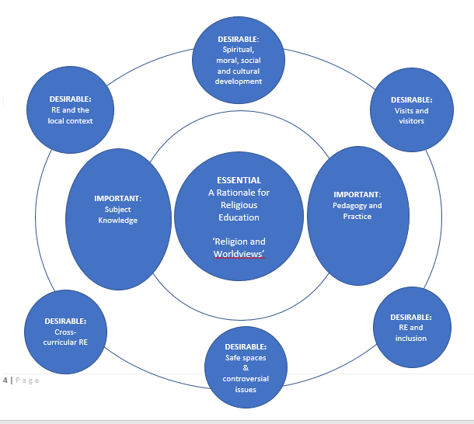

Slide 5
55 have signed up to do the self-study course
Very useful to me as I start my new adventure in a SCITT, leading RE training. I will definitely refer to this as I plan my day with trainees
The conference will support my work with my RE specialist BEd3 students
Excited about it, will share with other staff in our middle school RE group
I very much like the distribution of essential, important and desirable.

